Slide 1

Project Title -
HEALTH CARE ANALYSIS
LIKHITHA VADDHI
STU6825ae98cff401747299992

Slide 2

PROBLEM STATEMENT
Healthcare organizations generate large amounts of patient and visit-related data. Without systematic analysis, it can be difficult to understand patterns in doctor visits and the factors associated with healthcare utilization. This project analyzes doctor visit data to identify patterns related to demographics, income, illness, health status, chronic conditions, and healthcare coverage.

Slide 3
Project Description
Healthcare Analytics for Doctor Visits is a data analytics project that examines patient and healthcare utilization data to understand doctor visit patterns. The project involves data cleaning, exploratory data analysis, statistical analysis, correlation analysis, and visualization. The insights can support healthcare organizations in understanding utilization patterns and planning resources more effectively.

Slide 4

WHO ARE THE END USERS?
• Hospitals and Healthcare Organizations
• Healthcare Administrators
• Doctors and Care Teams
• Healthcare Analysts
• Healthcare Researchers
• Policy and Planning Teams

Slide 5

Technology Used
  Python
  Pandas
  NumPy
  Matplotlib
  Seaborn
  Google Colab
  CSV Dataset

Slide 6
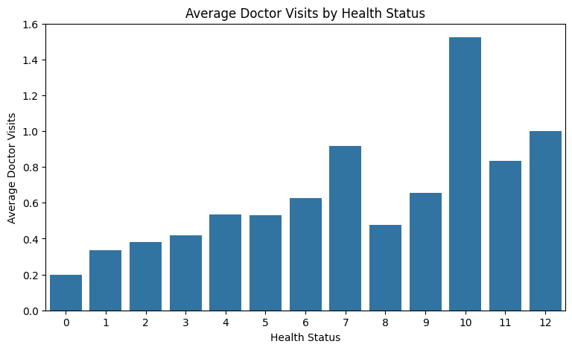
RESULTS

Slide 7
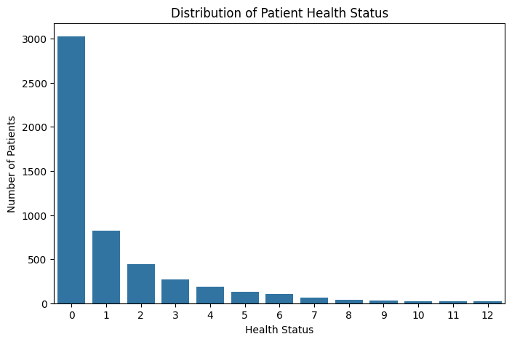
RESULTS
https://gihub.com/Likhithavaddhi/Healthacare-analysis/tree/main

Slide 8
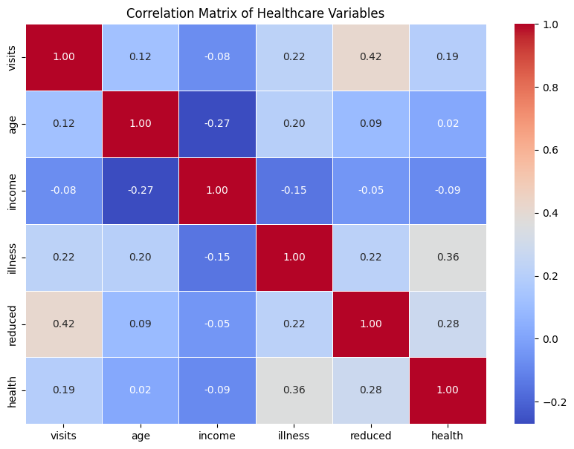
RESULTS
Demo Link

Slide 9
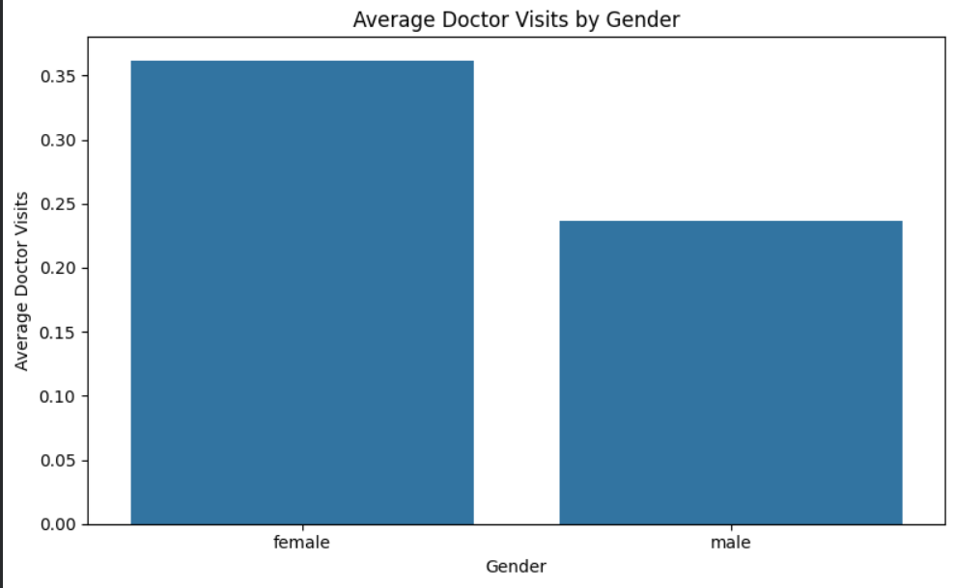
RESULTS
https://github.com/Likhithavaddhi/Healthacare-analysis/tree/main

Slide 10
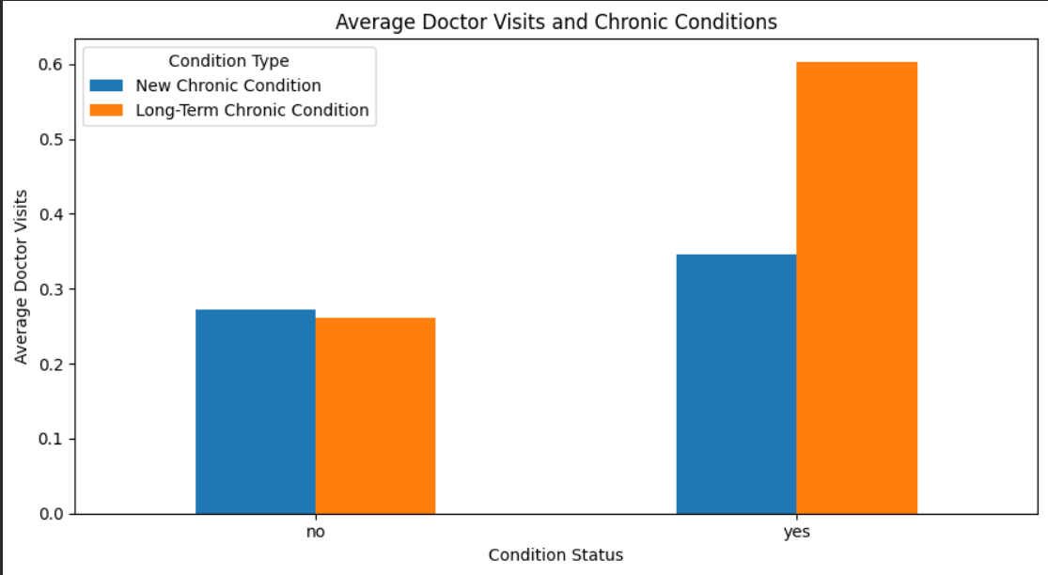
RESULTS
https://github.com/Likhithavaddhi/Healthacare-analysis/tree/main

Slide 11
Thank you
GITHUB LINK :
https://github.com/Likhithavaddhi/Healthacare-analysis/tree/main
.
.

